Slide 1
Electrochemistry
Electrochemistry is the study of the relationship between chemical change and electrical work. It involves chemical reactions which involve reduction and oxidation process.
Electrochemistry is the study of the interchange of chemical and electrical energy.
In electrochemistry we are interested in the ways in which we can extract work from chemical reactions in the form of electricity and we are also interested in how we can use electrochemical processes in order to synthesize chemical compounds of interest, that may be thermodynamically unfavorable.

Slide 2
Electrochemistry
Charge transfer includes:
oxidation-reduction (redox) reaction in which electrons are transferred between reactants
charge separation ( across a membrane as a biochemical phenomena or in ion selective electrode)
photosynthesis
combustion
Many of the above phenomena are related to energy or power generation. At the heart of many electrochemical phenomena is this idea of conversion of chemical energy into usable energy.

Slide 3
Electrochemistry :
Equilibrium 1) Redox
2) Ion selective : Homogeneous: pH, pF
Heterogeneous
Liquid ion exchange
3) Ion Sensitive Field Effect Transistor (ISFET)
Dynamic 1) Voltammetry : Polarography
Cyclic voltammetry
Stripping voltammetry : Anodic
Cathodic
Adsorptive
2) potentiometry
3) Coulometry

Slide 4
Redox reaction
A redox reaction involves transfer of electrons from one species to another.
Oxidation : loss of electrons
Reduction : gain of electrons
Oxidizing agent (oxidant):
takes (accepts)electrons
Reducing agent (reductant):
gives (donates) electrons
Half reaction : a balanced chemical equation that describes either the oxidation or reduction but not both.
Ox₁ + ne → Red₁
Red₂ → Ox₂ + ne
Net reaction :
Ox₁ + Red₂ → Ox₂ + Red₁
If we know how many moles of electrons are transferred, then we know how many moles of product have been formed.

Slide 5
Redox reaction
e–
X_{ox}
X_{red}
transfer or shift of electrons
X_{ox} loses electrons
X_{ox} is oxidated
X_{ox} is the reducing agent
X_{ox} increases oxidation number
X_{red} gain electrons
X_{red} is reduced
X_{red} is the oxidizing agent
X_{red} decreases oxidation number

Slide 6
Balancing Reduction Oxidation Reactions
Identify half-reactions
Determine acidity or alkalinity
Balancing methods
electron change
ox or red and electron charge balance
add e– s
add H⁺
add H₂O
Proton method
add H₂O
add H⁺
add e– s
balance e– s in each rxn. and add rxns.

Slide 7
Balancing Redox Equations
Complete and balance the following equation after adding H⁺ ,OH⁻, or H₂O as needed.
MnO₄– + NO₂– ↔ Mn²⁺ + NO₃–
First, we write and balance the two half-reactions involved, For MnO₄– , we write
MnO₄– ↔ Mn²⁺
Add 4 molecules of H₂O to account for the 4 oxygen atoms on the left-hand side of the equation, which means that we must provide 8 H⁺ on the left:
MnO₄– + 8 H⁺ ↔ Mn²⁺ + 4H₂O
to balance the charge, we need to add 5 electrons to the left side of the equation. Thus,
MnO₄– + 8 H⁺ + 5e– ↔ Mn²⁺ + 4H₂O

Slide 8
Balancing Redox Equations
For the other half-reaction,
NO₂– ↔NO₃–
We add one H₂O to the left side of the equation to supply the needed oxygen and 2H⁺ on the right to balance hydrogen
NO₂ – + H₂O ↔ NO₃– + 2H⁺ + 2e–
Before combining the two equations , we must multiply the first by 2 and the second by 5 so that the number of electrons lost will be equal to the number of electrons gained. We then add the two half – reactions to obtain
2MnO₄– +16H⁺ +10e– +5NO₂– + 5H₂O ↔ 2Mn ²⁺ + 8H₂O + 5NO₃– +
10H⁺ +10e–
which then rearranges to the balanced equation
2MnO₄– + 16H⁺ + 5NO₂– ↔ 2Mn²⁺ + 5NO₃– + 3H₂O

Slide 9
Relation between chemistry and electricity
The quantity of electrons that flow from a reaction is proportional to the quantity of analyte that reacts.
The electric force(voltage) is related to the identity and concentrations of reactants and products.

Slide 10
Electric measurements
A. Charge : q
Electric charge (q) is measured in coulombs (C).
The magnitude of the charge of a single electron is 1.602 × 10⁻¹⁹ C.
1 mole of electrons has a charge of 9.649 × 10⁴ C which is called the Faraday constant (F)
q = Avogadro’s number × charge of an electron
q = nF
Coulombs = moles(coulombs/mole)
Faraday constant : F= 96485.381 C/mol

Slide 11
Example
What weight in grams of Cu will be plated out from a solution of Cu²⁺ on passing 0.15 Faraday ?
Cu²⁺ +2e = Cu
Two Faradays plate out one mole (63g) of Cu. Therefore,
Weight = 0.15 Faraday × (½ moles / Faraday) ×(63g/mole)

Slide 12
B. Electric Current : I
The quantity of charge flowing each second through a circuit is called the current. The unit of current is the ampere (A).
Current = Charge / Unit time = Amp = Coulomb / sec
I = q /s
A = C/s

Slide 13
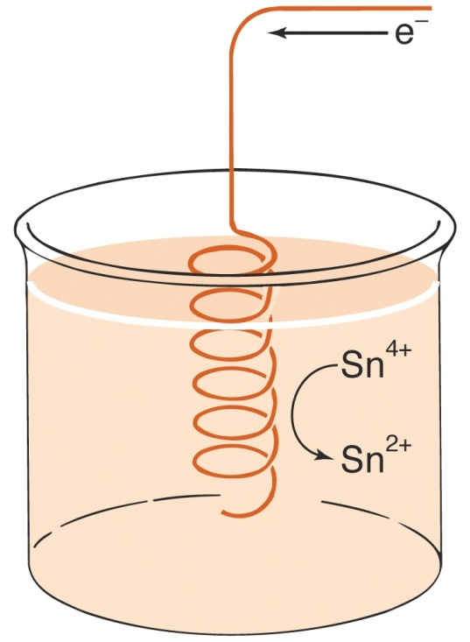
Example
Two electrons are required to reduce one Sn⁴⁺ ion:
Sn⁴⁺ + 2e → Sn²⁺
If the metal reacts at a rate of 4.24 mmol/h, electrons flow at a rate of 2× 4.24 mmol/h, which corresponds to
(2× 4.24 mmol/h) / 3600 s/h = 2.356 ×10 ^{–3} mmol/s
= 2.356 ×10 ^{–6} mol/s
To find current, we convert moles of electrons per second to coulombs per second
Current = charge / time = coulombs / second
= (moles/second) × (coulombs / mol)
= (2.356 ×10 ^{–6} mol/s) × (9.649 × 10⁴ C/mol)
= 0.227 C/s
= 0.227 A
Electrons flowing into a coil of Pt wire at which Sn⁴⁺ ions in solution are reduced to Sn²⁺ ions. This process could not happen by itself because there is no complete circuit.

Slide 14
C. Electric Potential : E
The difference in electric potential (E) between two points is a measure of the work that is needed when an electric charge moves from one point to another. Potential difference is measured in volts (V).
Electrical energy = voltage acting on an electrical charge
Energy = Joule = Coulomb × Volt
Electric potential = Energy / Unit charge = V = E
V = J/C
The greater the potential difference between two points, the stronger will be the "push" on a charged particle traveling between those points. A 12 V battery will push electrons through a circuit 8 times harder than a 1.5 V battery.
Cell Potential : depending on the nature of the chemical reactions occurring, the driving force on the electrons to flow in the circuit will be different. We term this the cell potential ( E_{cell} ) or the electromotive force ( emf ). Electromotive force is typically measured in terms of voltage. The cell potential is expressed in Volts.
Volts = work(J) / charge(coulombs)

Slide 15
D. Work :
Electrochemical work
Work = Potential × Current × Time = Potential × Charge
work = Eq
joule = (volts )(coulombs)
E. Free energy :
The free energy change, ΔG, for a chemical reaction conducted reversibly at constant temperature and pressure equals the maximum possible electrical work that can be done by the reaction on its surroundings
work = −ΔG
ΔG = −work = – Eq = – nFE
Δ G = Δ H – T Δ S, if Δ G > 0, reaction is not favored, Δ G < 0, reaction is favored

Slide 16
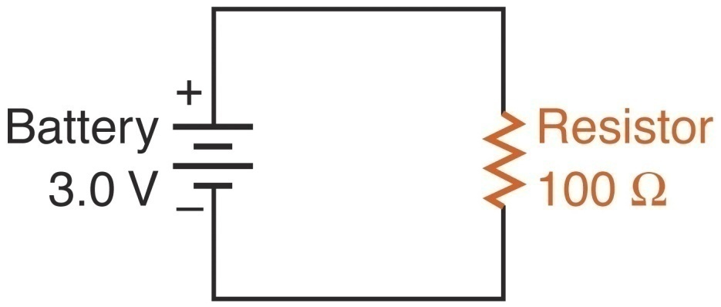
F. Ohm’s law
E = IR
V = AΩ
G. Power
Power = Work / Unit time = Current × Potential = VA = W
P = work/s = Eq / s = EI = (IR)I = E(E/R)
Example
E = IR
I = E/R = 3.0V / 100Ω
= 0.030A = 30 mA
P = EI = 3.0V×0.030A
= 0.090W = 90mW

Slide 17
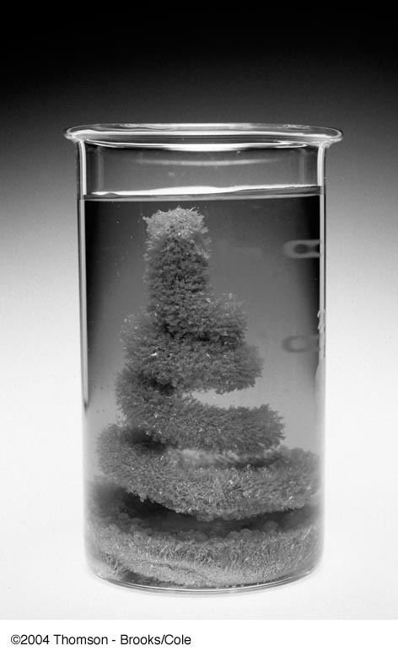
Redox reactions in electrochemical cell
A piece of copper is immersed in a silver nitrate solution. Silver ions migrate to the metal and are reduced.
Ag⁺ + e ↔ Ag(s)
At the same time, an equivalent quantity of copper is oxidized :
Cu(s) ↔ Cu²⁺ + 2e
We obtain a net ionic equation for the overall process.
2Ag⁺ + Cu(s) ↔ 2Ag(s) + Cu²⁺
K = [Cu²⁺] / [Ag⁺]² = 4.1 × 10¹⁵

Slide 18
Salt bridge
A salt bridge is an ionic medium with semipermeable barrier on each end.
Small molecules and ions can cross a semiperable barrier, but large molecules cannot.
Electrochemical cells are often equipped with a salt bridge to separate the electrolyte in the anode and cathode compartments.
The salt bridge consists of U-shaped tube filled with a gel containing saturated solution of KCl (>3.7M).
Such a cell has two liquid junctions. The salt bridge allows ions to flow in and out of the solutions as necessary to maintain electroneutrality ( no charge built up) throughout the cell.
The function of the salt bridge is allow ion motion between the two compartments without allowing mixing of the solutions. During the electrochemical reaction, the K⁺ ions move toward cathode to offset the build up of negative charge, and chloride ions move toward the anode to offset the build up of positive charge.

Slide 19
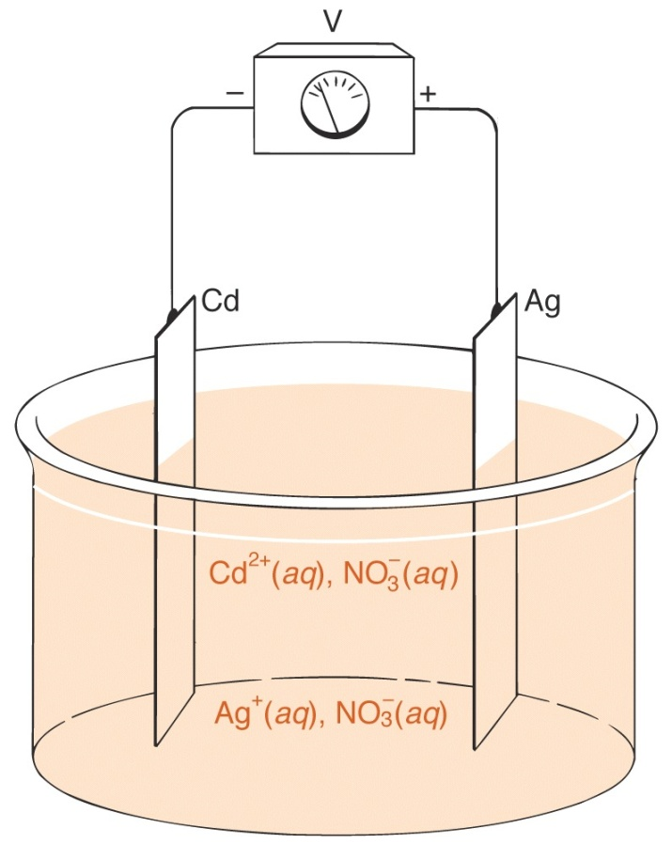
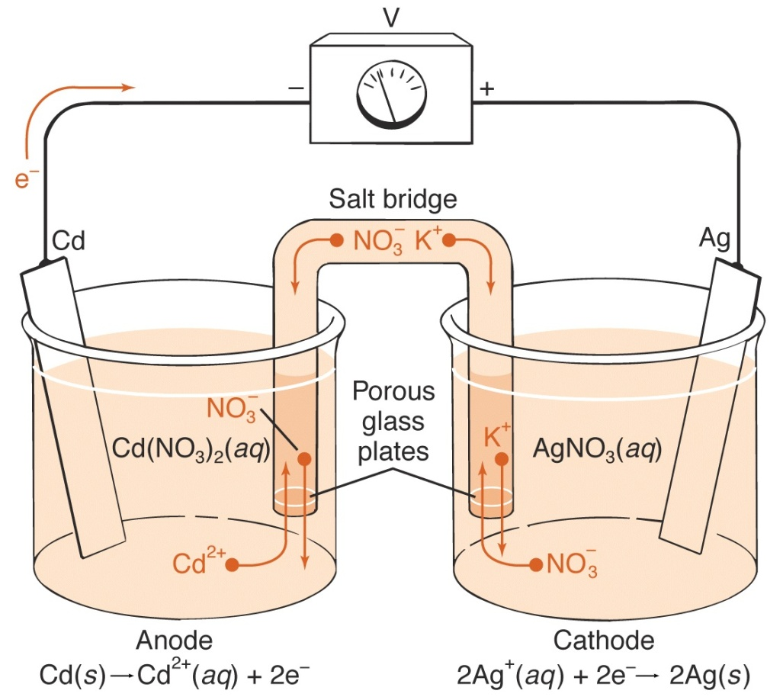
A cell that will not work. The solution contains Cd(NO₃)₂ and AgNO₃.
A cell that works – thanks to the salt bridge !
Cathode: 2Ag⁺(aq) + 2e = 2Ag(s)
Anode: Cd(s) = Cd²⁺(aq) + 2e
Net reaction: 2Ag⁺(aq) + Cd(s) = 2Ag(s) + Cd²⁺(aq)

Slide 20

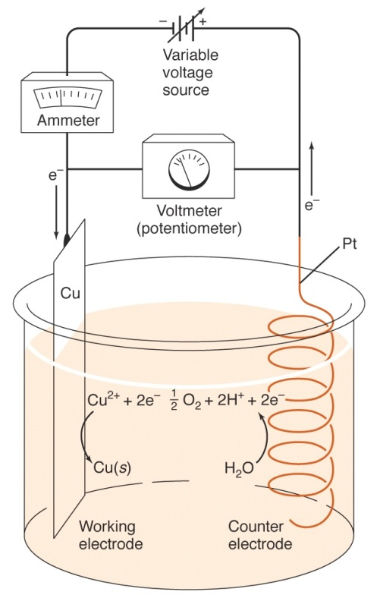
Galvanic Cell
Cell : A cup, jar, or vessel containing electrolyte solution and metal electrodes to produce an electric current or for electrolysis
Galvanic cell (voltaic cell) is a device in which chemical energy is converted to electrical energy. Galvanic cell produces electrical energy spontaneously (spontaneous cell reaction).
Electrolytic cell requires electrical energy from an external source.

Slide 21
Cell convention
Anode : the electrode at which oxidation occurs.
Because oxidation is occurring here, electrons must be flowing into the anode from the solution. This gives the anode a negative charge and an excess of electrons.
Cathode : the electrode where reduction takes place.
Because reduction is occurring here, electrons must be flowing from the cathode into the solution, therefore this electrode will be losing electrons and will have a positive charge.
The excess electrons at the anode will then be attracted to the positive charge on the cathode and will flow through the external wire allowing us to extract work from this flow as it proceeds.
These definitions apply to both galvanic and electrolytic cells.
When electrons flow into a potentiometer(voltmeter) through its negative terminal, the meter indicates a positive voltage.

Slide 22
Cell convention
The left-hand electrode of each cell is connected to the negative input terminal of the meter. This will produce a positive voltage whenever oxidation occurs at left-hand electrode.
Liquid junctions are employed to avoid direct reaction between the components of the two half-cells.
The magnitude of the half cell potential is a quantitative measure of the tendency of the half reaction to proceed to the right.
A spontaneous reaction has positive potential.
If the direction of the half reaction is reversed the sign of the voltage is reversed.

Slide 23
Anode (Ox) : Zn(s) = Zn²⁺ + 2e
Cathode (Red) : Cu²⁺ + 2e = Cu (s)
Net reaction : Zn (s) + Cu²⁺ = Zn²⁺ +Cu (s)
Movement of charge in a galvanic cell :
left-to right flow of positive ions
right-to left flow of negative ions
e
Anode Zn
–
+
V
Cathode Cu
ZnSO₄
Porous fritted disk (liquid junction)
CuSO₄

Slide 24
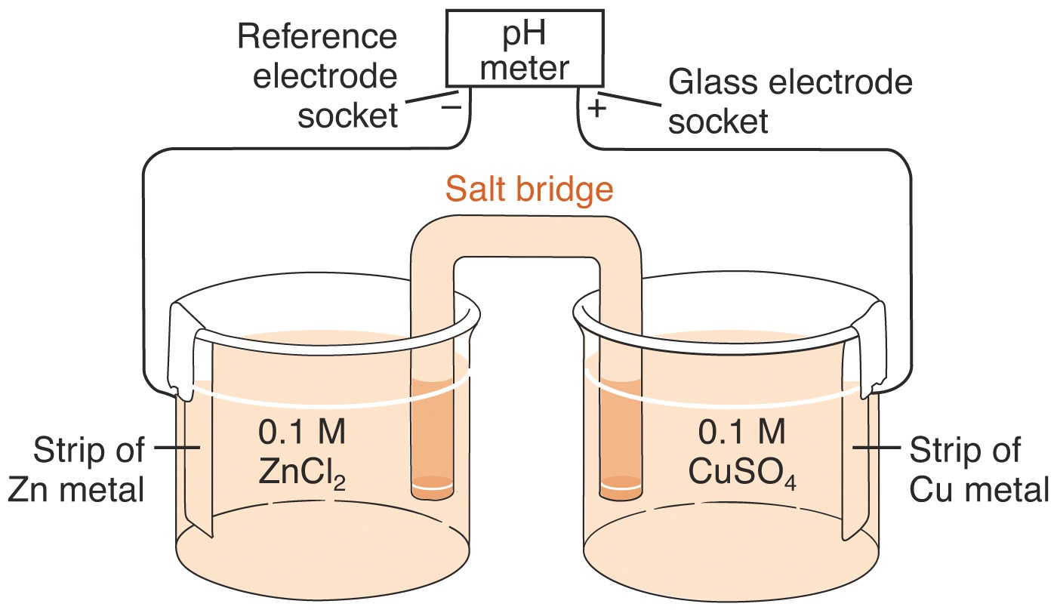
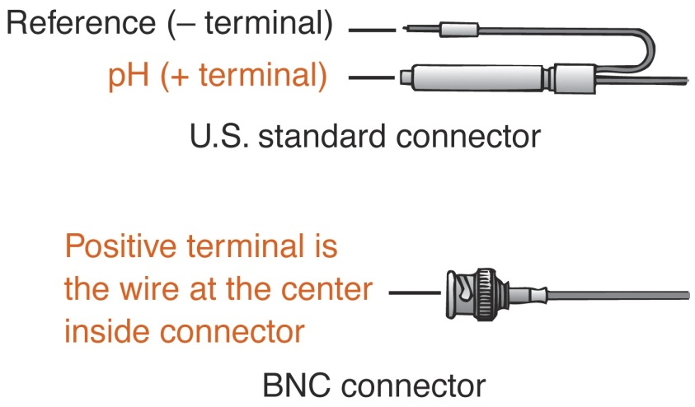
Setup for the galvanic cell
The convention for cell is called the plus right rule; it implies that we always measure the cell potential by connecting the positive lead of the voltmeter to the right-hand electrode in the schematic or cell drawing. The leads of voltmeters are color coded. The positive lead is red and the common, or ground, lead is black.

Slide 25
Cells without junctions or salt bridges
Sometimes useful cells can be constructed in which the electrodes share a common electrolyte. The lead storage battery used in automobiles is a collection of such cells. The electrode reactions are :
Cathode : PbO₂ (s) + 4H⁺ + SO₄^{2–} + 2e = PbSO₄(s) + 2H₂O
Anode : Pb(s) + SO₄^{2–} = PbSO₄(s) + 2e
PbO₂ (s) + Pb(s) + 4H⁺ + 2SO₄^{2–} = 2PbSO₄(s) + 2H₂O
Pb⁺² + SO₄^{2–} = PbSO₄(s) K_{sp} = 1.6×10^{–8}.
Eº = 2V, ΔHº= –315.62 kJ/mol, ΔGº= –394.38 kJ/mol
ΔG = ΔGº + RT log ( 1 / [H⁺]⁴[SO₄^{2–} ]²)
At equilibrium, ΔG = 0 and [H⁺] = 6.4 ×10^{–12}, [SO₄^{2–} ]= 3.2×10^{–12}.
The battery has been discharged and the reaction is at equilibrium.
V
Pb
PbO₂
H₂SO₄ Saturated
with PbSO₄

Slide 26
Rechargeable battery
A battery in which the chemical reaction system providing the electrical current is easily "chemically" reversible.
After discharging, it can be recharged by applying an electrical current to its terminals. Some batteries can be recharged hundreds to thousands times.
For example the lead-acid battery, also called “secondary” battery, and “accumulator.” Contrast with non-rechargeable battery.
It operates as a galvanic cell during discharge and as an electrolytic cell during charge.
As a consequence, the anode is the negative electrode during discharge, while it is the positive electrode during charge; at the same time, the cathode is the positive electrode during discharge, while it is the negative electrode during charge.
This can create a confusing situation, and it is preferable to refer to the electrodes of a rechargeable battery as “positive” and “negative,” because this designation is independent of the operational mode. Unfortunately, this nomenclature is not always followed.
Often the “negative” electrode is designated as anode and the “positive” electrode is designated as cathode. This naming convention is a carry-over from the convention of the non-rechargeable battery.

Slide 27
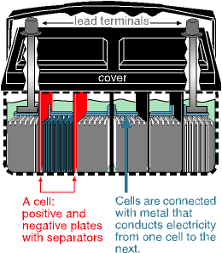
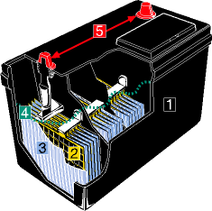
Lead-acid battery
A rechargeable battery. During discharging, the reaction on the positive electrode is the conversion of lead dioxide to lead sulfate, while on the negative electrode it is the conversion of metallic lead to lead sulfate.
The reactions are reversed during charging. The current collector can be lead in both electrodes. The electrolyte is sulfuric acid. While it is one of the earliest practical storage batteries (1866), it is still very widely used today, e.g. as automobile starter battery.
http://electrochem.cwru.edu/ed/dict.htm#r01
http://www.uuhome.de/william.darden/carfaq.htm#4

Slide 28
Voltages of some voltaic cells
Voltaic cell Voltage (V)
Common alkaline battery 1.5
Lead-acid car battery 2.0
(6cells = 12.0 V)
Calculator mercury battery 1.3
Electric eel 0.15
(~5000 cells in 8 ft eel = 750V)
Nerve of giant squid 0.070
(across cell membrane)

Slide 29
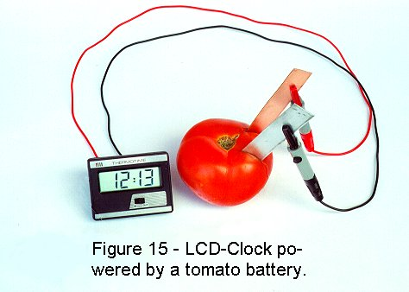
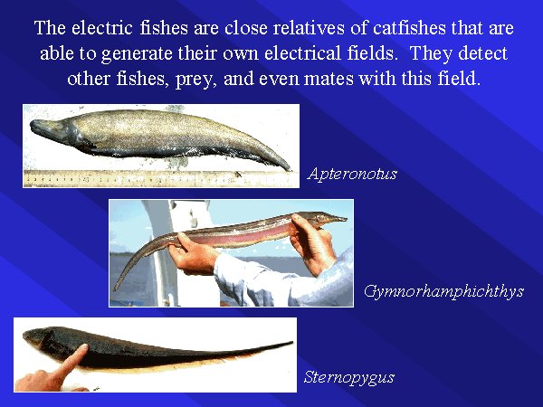
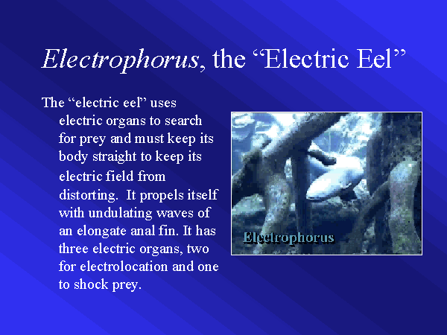
http://www.intelligentdesign.org/menu/whofirst/electricity/electricity.htm
http://www.umich.edu/~bio440/NeotropicalDiversity/sld029.htm

Slide 30
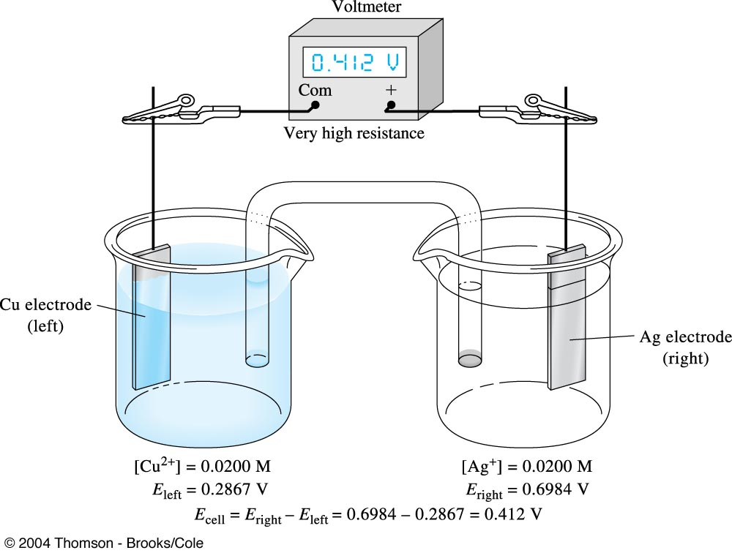
Change in cell potential after passage of Current until equilibrium is reached. In (a), the high-resistance voltmeter prevents any significant flow, and the full open circuit cell potential is measured. For the concentrations shown this is +0.412V.

Slide 31
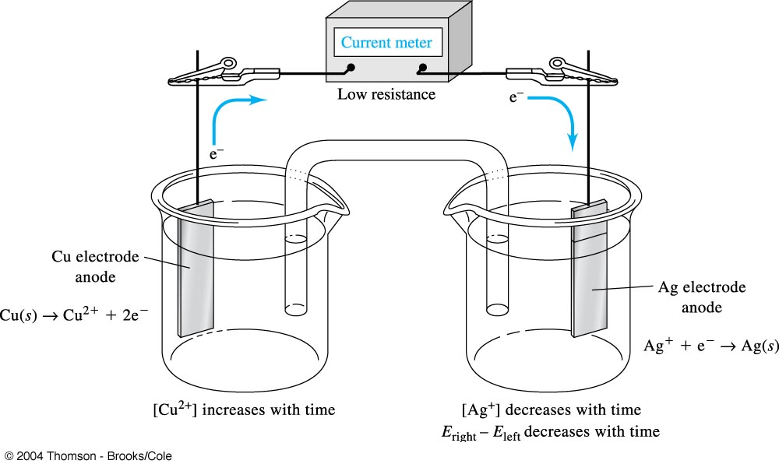
In (b), the voltmeter is replaced with a low-resistance current meter, and the
cell discharges with time until eventually equilibrium is reached.

Slide 32
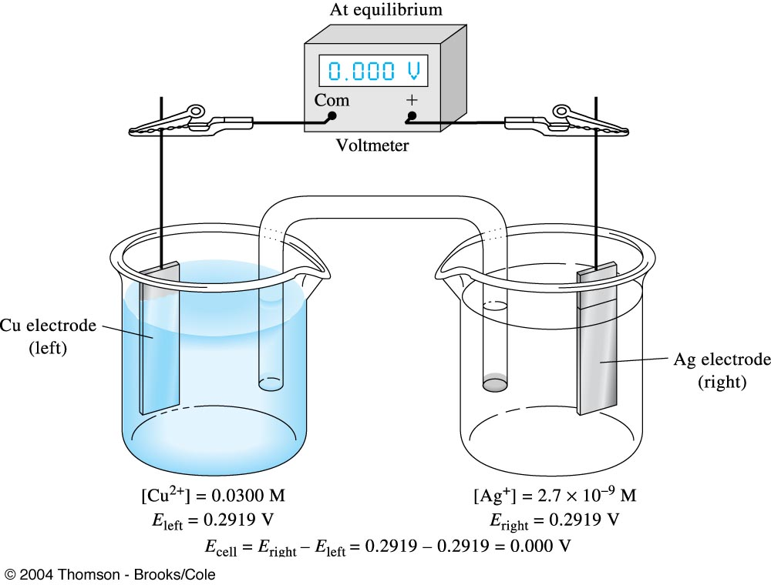
In (c) , after equilibrium is reached, the cell potential is again measured with a voltmeter and is found to be 0.000V. The concentration in the cell are now those at equilibrium as shown.

Slide 33
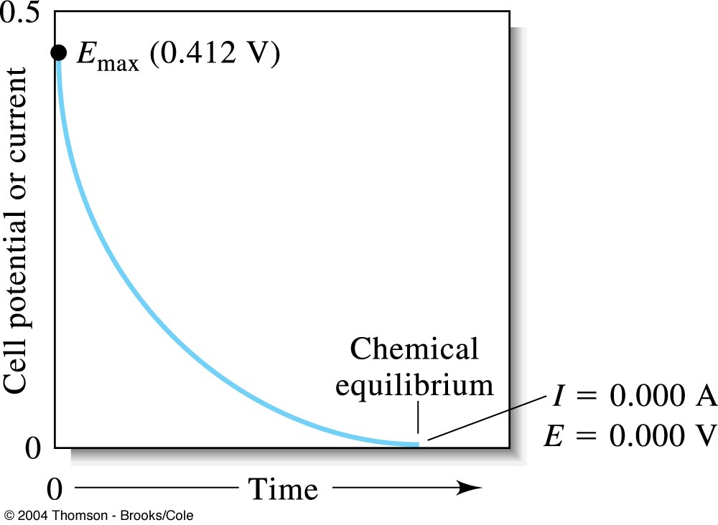
2Ag⁺ + Cu(s) ↔ 2Ag(s) + Cu²⁺
Cell potential in the galvanic cell as a function of time. The cell current, which is directly related to the cell potential , also decrease with the same time behavior.

Slide 34
Schematic representation of cells ; line-notation :
Chemist have developed a shorthand notation for representing electrochemical cells.
A phase boundary across which a potential difference exists is represented by a single vertical line.
A salt bridge is represented by double vertical lines.
Example. Line diagram
Zn(s) ZnSO₄ (conc) CuSO₄(conc) Cu(s)
Cd(s) CdCl₂ (aq) AgNO₃ (aq) Ag(s)
Pt SnCl₂ (conc), SnCl₄(conc) FeCl₃ (conc), FeCl₂(conc) Pt
inert electrode : an electron bank, dispensing and receiving electrons to and from the substance in the solution

Slide 35
Rules for representing electrochemical cells:
1. Use a double-vertical lines to present the salt bridge
Anode compartment || Cathode compartment
2. Separate the cell reaction into half reactions
eg. Anode reaction : Ag → Ag⁺ + e
Cathode reaction: Fe³⁺ + e → Fe²⁺
3. Using normal chemical formulas, write the components of the anode and cathode half reactions.
eg. Ag Ag⁺ || Fe³⁺ Fe²⁺
4. In parenthesis, write the concentrations of the solutes in anode and cathode compartments.
eg. Ag Ag⁺ (0.1M) || Fe³⁺ (0.1M) Fe²⁺ (0.1M)
5. Using single-vertical line, represent the interface between the solution and the electrode. Place a vertical line and insert inert conductor to serve as the solid electrode conductor.
eg. Ag | Ag⁺ (0.1M) || Fe³⁺ (0.1M) , Fe²⁺ (0.1M) | Pt

Slide 36

Ex. Voltage produced by a chemical reaction
Cd(s) CdCl₂ (aq, 0.0167M) AgCl(s) Ag(s)
Ox : Cd (s) = Cd²⁺(aq) + 2e
Red : 2AgCl(s) + 2e = 2Ag(s) + 2Cl–(aq)
Net : Cd (s) + 2AgCl(s) = Cd²⁺(aq) + 2Ag(s) + 2Cl–(aq)
ΔG = – 150 kJ / mol of Cd
ΔG = –nFE
E = ΔG / (–nF) = (150×10³J) /{–(2mol)×9.649×10⁴(C/mol)}
= + 0.777J/C
= + 0.777V

Slide 37
Why We cannot Measure Absolute Electrode Potentials
Although it is not difficult to measure relative half-cell potentials, it is impossible to determine absolute half-cell potentials because all voltage-measuring devices measure only differences in potential.
To measure the potential of an electrode, one contact of a voltmeter is connected to the electrode in question. The other contact from the meter must then be brought into electrical contact with the solution in the electrode compartment via another conductor.
This is second contact, however, inevitably involves a solid/solution interface that acts as a second half-cell when the potential is measured. Thus, an absolute half-cell potential is not obtained. What we do obtain is the difference between the half-cell potential of interest and a half-cell made up of the second contact and the solution.
Our inability to measure absolute half-cell potentials presents no real obstacle because relative half-cell potentials are just as useful provided that they are all measured against the same reference half-cell.
Relative potentials can be combined to give cell potentials. We can also use them to calculate equilibrium constants and generate titration curves.

Slide 38
Standard potentials ; Eº
When all substances involved in the half-reaction are present in their standard-state concentrations(activities), an electrode has its standard potential, Eº. Standard conditions means that all activities are unity(A=1).
Standard hydrogen electrode (SHE) : normal hydrogen electrode(NHE)
Pt | H₂(g, 1.0 atm)| H⁺(aq, A= 1.0M)
By convention, the potential of S.H.E. is assigned a value of exactly zero volt at all temperatures. S.H.E is the universal standard of reference.
½ H₂(g, 1.0 atm) = H⁺(aq, A= 1.0M) + e Eº = 0.000 V
Δ Eº_{cell} = Eº_{M} – Eº_{SHE} = Eº_{M}

Slide 39
Standard potentials ; Eº
The sign of the electrode potential will indicate whether or not the reduction is spontaneous with respect to the S.H.E..
The most effective oxidizing agents are those species which have largest positive Eº values. In the opposite sense, these species are most easily reduced.

Slide 40
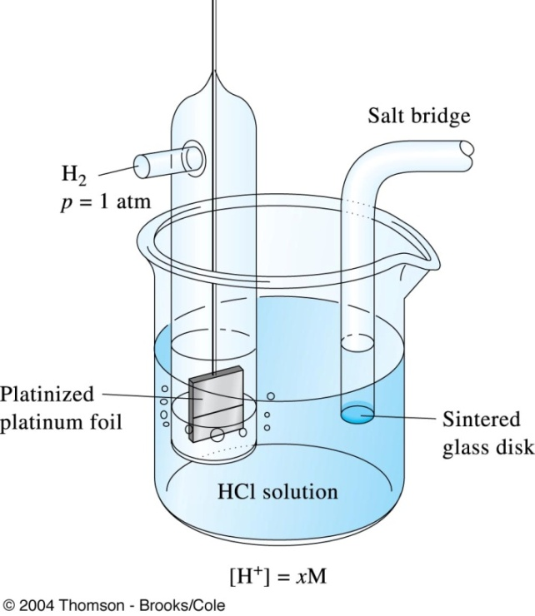
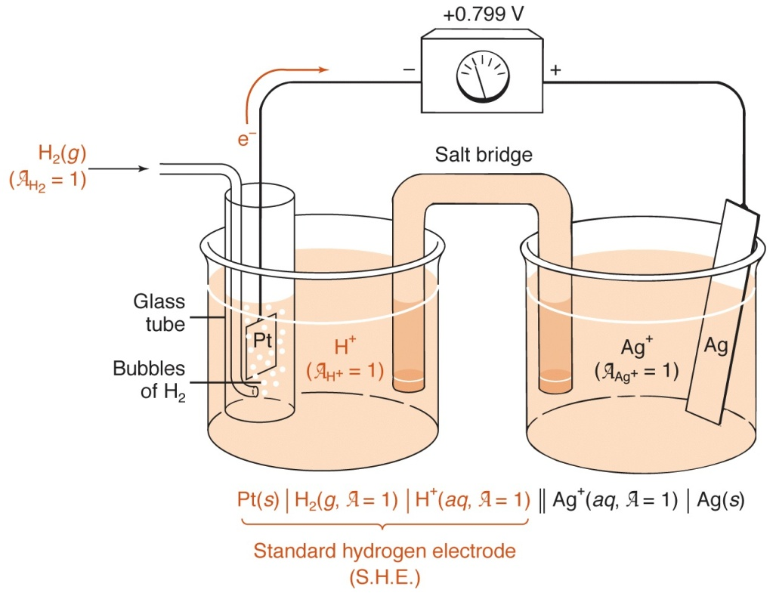
Measurement of the electrode potential for an Ag electrode
If the silver ion activity in the right-hand compartment is 0.00, the cell potential is the standard electrode potential of the Ag⁺/Ag half reaction.
H⁺(aq, A= 1) + e⁻ = ½ H₂(g, A= 1) Eº = 0.000 V
Ag⁺ + e⁻ = Ag(s) Eº = + 0.799V
Eº_{cell} = Eº_{right} – Eº_{left} = Eº_{Ag} – Eº_{SHE} = Eº_{Ag} – 0.000 = Eº_{Ag}

Slide 41
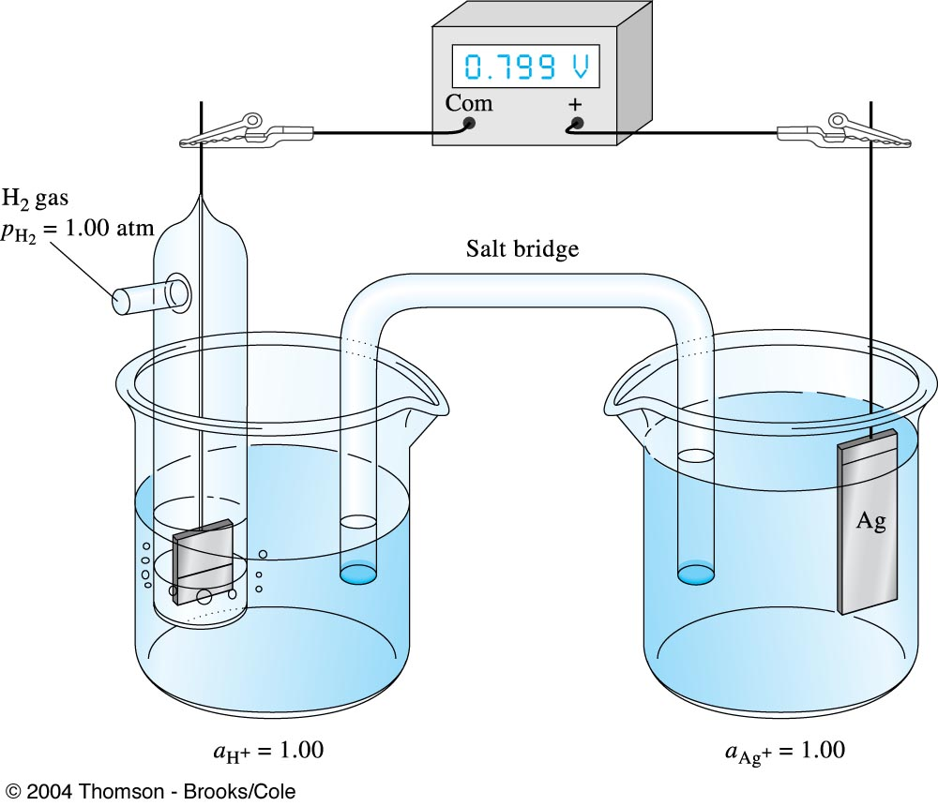
Measurement of the electrode potential for an Ag electrode. If the silver ion activity in the right hand compartment is 1.00, the cell potential is the standard electrode potential of the Ag⁺/Ag half- reaction.

Slide 42

Measurement of the standard electrode potential for Cd ²⁺ + 2e– ↔ Cd(s)

Slide 43
Nernst equation
The effect of concentration on electrode potential
The quantitative relationship between the concentration of substances comprising a redox half-cell and the electrode potential of the half-cell was first described by the German chemist Nernst, and the equation bears his name.
Thus, for the general half-reaction
aA + bB + ne = cC + dD
E = Eº – (RT/nF) ln ([A_{C}]^{c}[A_{D}]^{d} / [A_{A}]ª[A_{B}]^{b})
= Eº – (RT/nF) ln Q
E = Eº – (RT/nF) ln ([C]^{c}[D]^{d} / [A]ª[B]^{b})
At 298ºK(25ºC)
E = Eº – (0.05916/n) log ([C]^{c}[D]^{d} / [A]ª[B]^{b})
E = Eº – (0.05916/n) log Q (at any time)
E = Eº – (0.05916/n) logK (at equilibrium)

Slide 44
Example: Calculation of electrode potentials from standard potential :
1) Potential for a half-cell consisting of a cadmium electrode immersed in a solution that is 0.0100M Cd²⁺
Cd²⁺ + 2e = Cd(s) Eº = – 0.402 V
E = Eº – (0.05916/2) log (1/[Cd²⁺])
= – 0.402 – (0.05916/2) log (1/0.0100)
= – 0.461V
2) calculate the electrode potential of a half-cell containing 0.100M KMnO₄ and 0.0500M MnCl₂ in a solution whose pH is 1.00.
MnO₄ – + 8H⁺ + 5e = Mn² ⁺ + 4H₂O Eº = 1.51
E = Eº – (0.05916/5) log ([Mn² ⁺] /[MnO₄ – ][H⁺]⁸)
= 1.51 – (0.05916/5) log {0.0500 / {0.100×(1.00×10^{–1}) ⁸}
=1.42 V

Slide 46
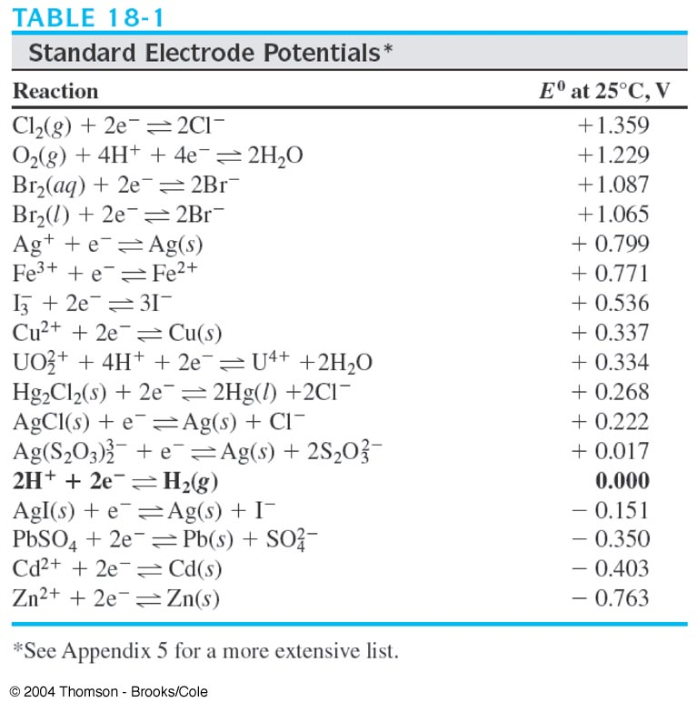

Slide 47
Two Electrode Potentials for Br₂
Br₂ (aq) + 2e⁻ ↔ 2Br⁻ E⁰ = +1.087V
Br₂ (l) + 2e⁻ ↔ 2Br⁻ E⁰ = +1.065V
The second standard potential applies olny to a solution that is saturated with Br₂ and not to undersaturated solutions. You should use 1.065V to calculate the electrode potentialof a 0.0100M solution of KBr that is saturated with Br2 and in contact with an excess of the liquid. In such a case,
E = 1.065 – (0.0592 /2) log [Br⁻]²
= 1.065 – (0.0592 /2) log(0.0100)²
= 1.065 – (0.0592 /2) x (-4.00) = 1.183V
In this calculation, no term for Br² appears in the logarithmic term because it is a pure liquid present in excess (unit activity).

Slide 48
The standard electrode potential shown in the first entry for Br₂ (aq) is hypotential because the solubility of Br₂ at 25℃ is only about 0.18M.
Thus, the record value of 1.087V is based on a system that- in terms of our definition of E⁰ – cannot be realized experimentally.
Nevertheless, the hypotential potential does permit us to calculate electrode potentials for solutions that are undersaturated in Br₂.
For example, if we wish to calculate the electrode potential for a solution that was 0.0100M in KBr and 0.00100M in Br₂. We would write
E = 1.087 – (0.0592 /2) log [Br⁻]₂/Br₂(aq)
= 1.087 – (0.0592 /2) log(0.0100)² / 0.00100
= 1.087 – (0.0592 /2) log 0.100
= 1.117V

Slide 49
Sign Conventions in the Older Literature
Reference works, particularly those published before 1953, often contain tabulations of electrode potentials that are not conform with the IUPAC recommendations.
Zn(s) ↔Zn²⁺ + 2e⁻ E = +0.76V
Cu²⁺ + 2e⁻ ↔Cu(s) E = +0.34V
To convert these oxidation potentials to electrode potentials as defined by the IUPAC convention, one must mentally (1) express the half-reactions as reductions and (2) change the signs of the potentials.

Slide 50
Sign Conventions in the Older Literature
The sign convention used in a tabulation of electrode potentials may not be explicitly stated.
This information can be readily deduced, however, by noting the direction and sign of the potential for a half-reaction with which one is familiar.
If the sign agrees with the IUPAC convention, the table can be used as is; if not, the signs of all of the data must be reversed.
For example,
O₂(g) + 4H⁺ + 4e⁻ ↔ 2H₂O E = +1.229V
The reaction occurs, spontaneously with respect to the standard hydrogen electrode and thus carries a positive sign. If the potential for this half-reaction is negative in a tabulation, it and all the other potentials should be multiplied by –1.

Slide 51
Finding relevant half-reactions
Write reduction reactions for each half-cell
Element in two oxidation states
Pb(s) | PbF₂ (s) | F⁻(aq) | | Cu²⁺(aq) | Cu(s)
Right half-cell : Cu²⁺ + 2e⁻ = Cu(s)
Left half-cell : PbF₂ (s) + 2e⁻ = Pb(s) + 2F⁻

Slide 52
Procedure for writing a net cell reaction & finding voltage
Step1. Write reduction both half-cell, find Eº
multiply for same elctron numbers, not Eº
Step2. Write Nernst equation for right half-cell, E₊
Step3. Write Nernst equation for left half-cell, E₋
Step4. Net cell voltage : Eº = E₊ – E₋
Step5. Balance net cell reaction

Slide 53
Measuring cell voltages
Calculating cell voltage :
Δ Eº_{cell} = V_{cell} = Eº_{cathode} – Eº_{anode}
Eº_{cell} = V_{cell} = Eº_{right} – Eº_{left}
Ex. Cd (s) + 2Ag⁺ = Cd²⁺(aq) + 2Ag(s)
Ag⁺ + e = Ag(s) Eº = + 0.799 V
Cd²⁺ + 2e = Cd(s) Eº = – 0.402 V
2Ag⁺ + 2e = 2 Ag(s) Eº = + 0.799 V
Cd²⁺ + 2e = Cd(s) Eº = – 0.402 V
Cd (s) + 2Ag⁺ = Cd²⁺(aq) + 2Ag(s)
Eº_{cell} = + 0.799 V – (– 0.402 V) = + 1.201 V

Slide 54
Standard electrode potentials for reactions involving precipitation
E_{cell} = Eº – (0.05916/2) log([Cd²⁺]/[Ag⁺]²)
Ksp AgCl =[Ag⁺][Cl–] = 1.8×10 ⁸
If [Cl–] = 0.0334M, [Cd²⁺] = 0.0167M
[Ag⁺] = 1.8×10 ⁸ / 0.0334 = 5.4 ×10^{–9} M
E_{cell} = Eº – (0.05916/2) log([Cd²⁺]/[Ag⁺]²)
= + 1.201 – (0.05916/2) log{0.0167 / (5.4 ×10^{–9} )²}
= 0.764V

Slide 55
Relation of Eº and the equilibrium constant
Eº = (0.05916/n) logK (at 25ºC, at equilibrium)
K =10 ^{nEo / 0.05916}
Ex. 1) Cu(s) + 2 Fe³⁺ = 2Fe²⁺ + Cu²⁺ Eº = 0.433 V
K =10 ^{nEo / 0.05916} = 10^{(2)(0.433) / (005916)} = 4 ×10¹⁴
2) Determining equilibrium constant of non-redox reactions
FeCO₃ + 2e = Fe(s) + CO₃^{2–} Eº = – 0.756 V
Fe(s) = Fe²⁺ + 2e Eº = – 0.400 V
FeCO₃ = Fe²⁺ + CO₃^{2–} Eº = – 0.316 V
K = Ksp =10 ^{(2)(-0.316) / (0.05916)} = 2 ×10^{–11}

Slide 56
Using cells as chemical probes
Pt(s) | H₂(1.00atm) |CH₃COOH(0.050M), CH₃COONa(0,0050M) || Cl–(0.10M) |AgCl(s) |Ag(s)
AgCl(s) = Ag⁺ (aq) + Cl– (aq)
CH₃COOH = H⁺ + CH₃COO–
AgCl(s) + e = Ag (s) + Cl– (aq) Eº = 0.222 V
H₂(g) = 2H⁺ (aq) + 2e Eº = 0 V
AgCl(s) + H₂(g, 1 atm) = Ag (s) + 2Cl– (0.10M) + 2H⁺ (xM)
E_{cell} = 0.222 – (0.05916 /2) log [H ⁺][0.10]² = 0.503 V(measured voltage)
[H⁺] = 1.76 ×10^{–4} M
K_{a} = [H⁺][CH₃COO–] /[CH₃COOH] = (0.0050)(1.76 ×10^{–4} ) / 0.050
= 1.8 ×10^{–5}

Slide 57
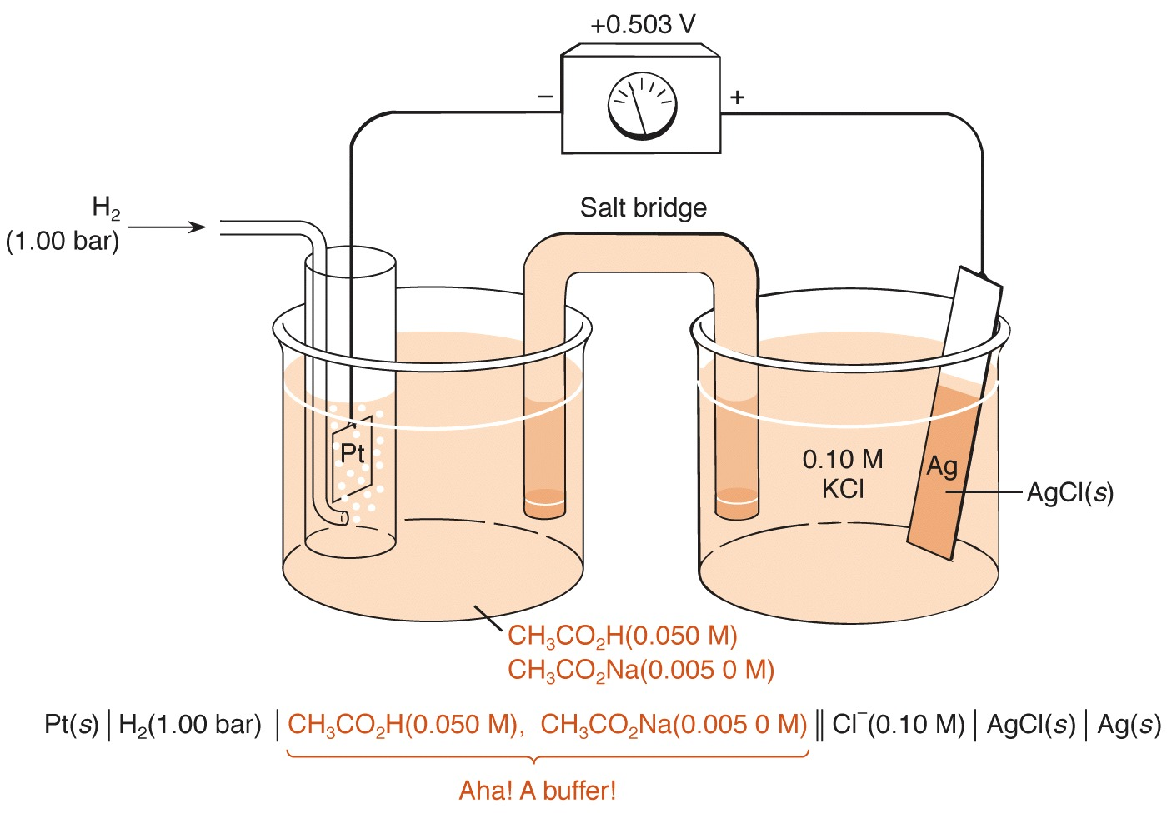
This galvanic cell can be used to measure the pH of the left half-cell.

Slide 58
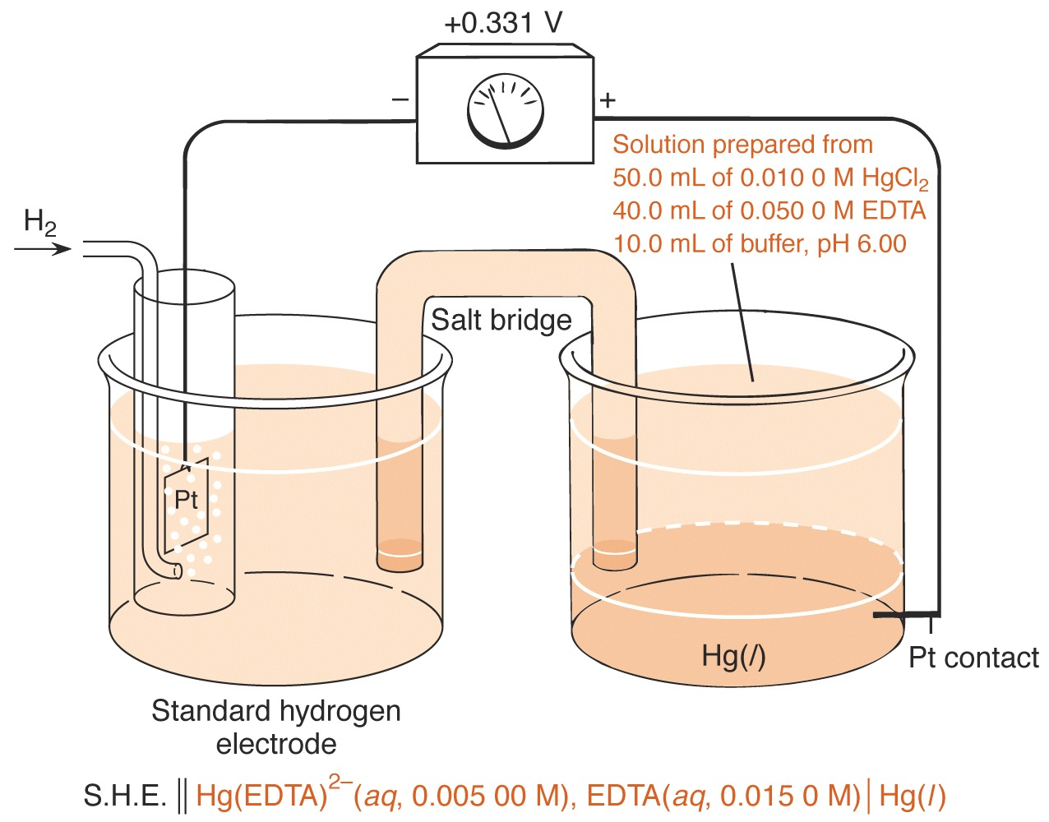
A galvanic cell that can be used to measure the formation constant for Hg(EDTA)^{2–} .

Slide 59
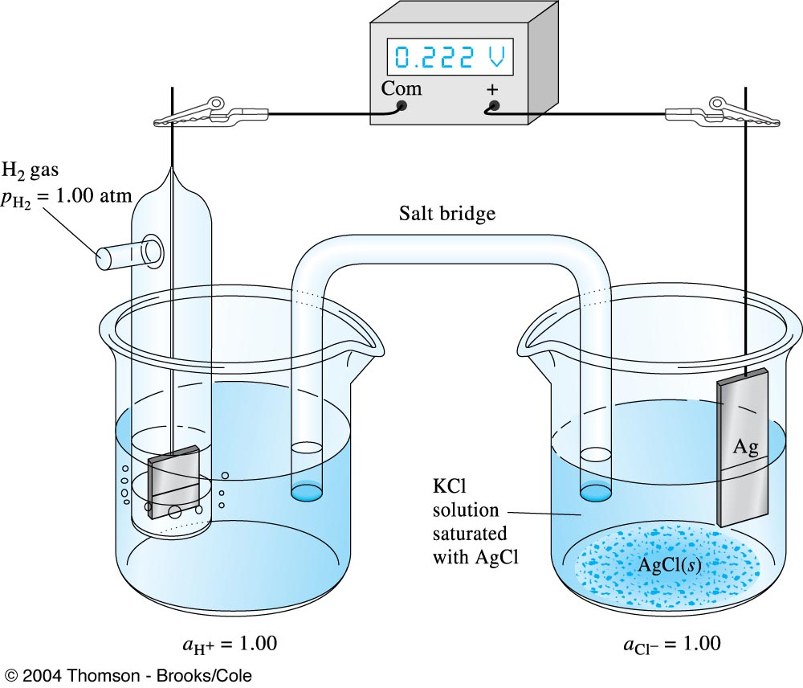
Measurement of the standard electrode potential for an Ag/AgCl electrode.

Slide 60
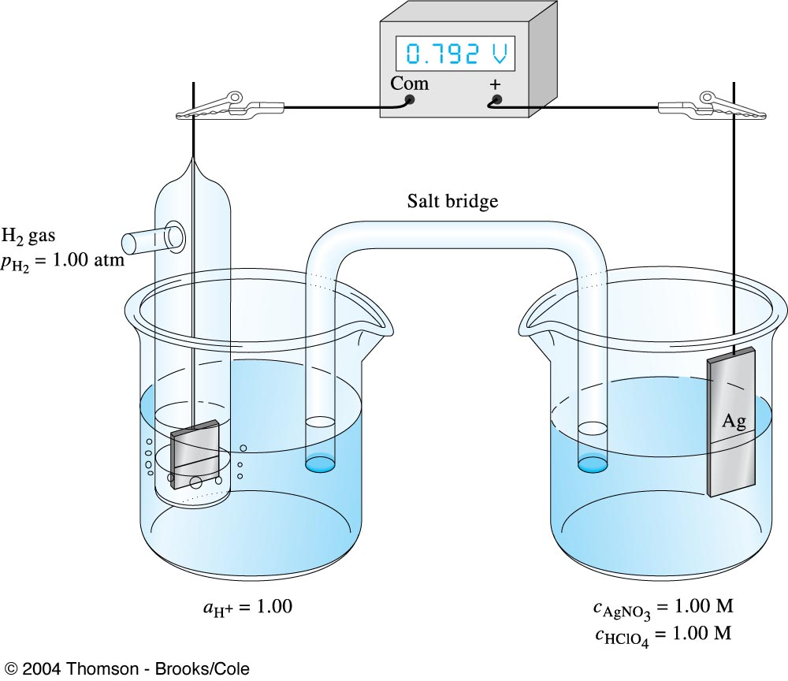
Measurement of the formal potential of the Ag⁺/Ag couple in 1M HClO₄.

Slide 61
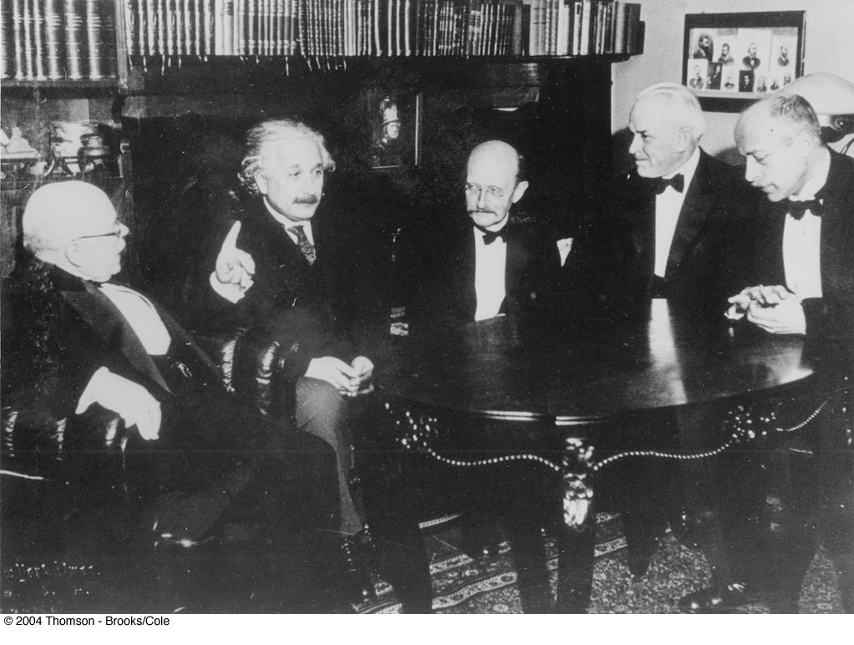
Walther Nernst(1864-1941) received the 1920 Nobel Prize in chemistry for his numerous contributions to the field of chemical thermodynamics. Nernst(far left) is seen here with Albert Einstein, Max Plank, Robert A. Millikan, and Max von Laue in 1928.

